Slide 1
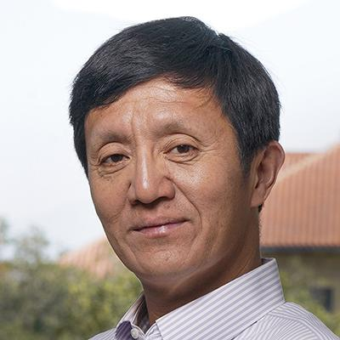
2023 SCBA Washington DC Chapter Annual Scientific Symposium
Society of Chinese Bioscientists in America
KEYNOTE SPEAKER
Saturday, October 7, 2023
Registration by 10/2/2023
http://xxx
(Abstract submission deadline 9/23/2023)
University of Maryland Lecture Hall (CHM 1407),
8051 Regents Drive, College Park, MD 20742
Co-organizers: Dr. Yuan Zhu (Children’s National Hospital) and Dr. Wei Li (National Institutes of Health)
Speakers
Xinzhong Dong (JHU/HHMI) Hui Lu (GWU)
Shuying Sun (Johns Hopkins) Chuan Hu (NCI/NIH)
Paul Liu (NHGRI/NIH) Chunling Yi (Georgetown)
Wei Zheng (NCATS/NIH) Jake Liang (NIDDK/NIH)
Ling Qi (UVa) Han-Yu Shih (NEI/NIH)
Dr. Liqun Luo
Stanford University/HHMI
Notes:
Bo Liu

